Slide 1
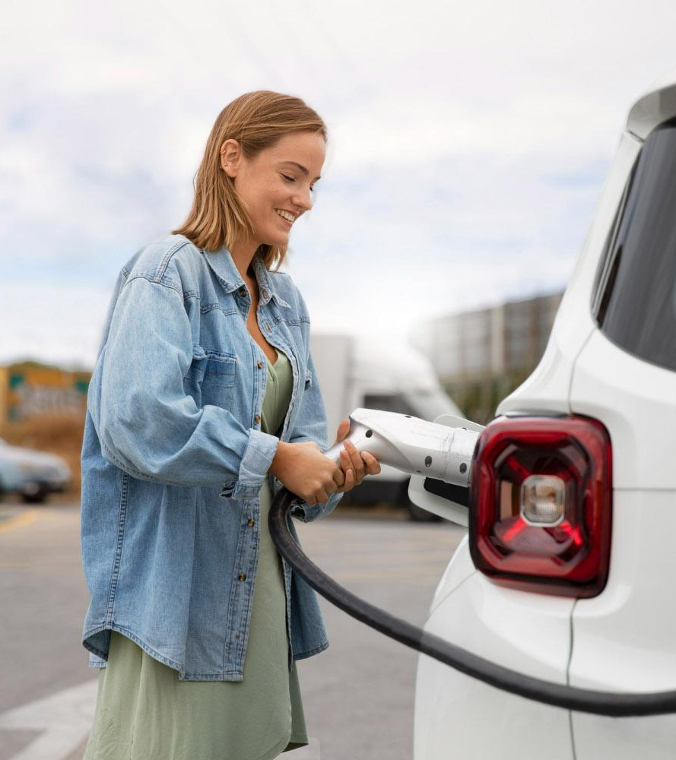
Prescriptive Analytics:
Tesla Supercharger Locations Optimization

Slide 2
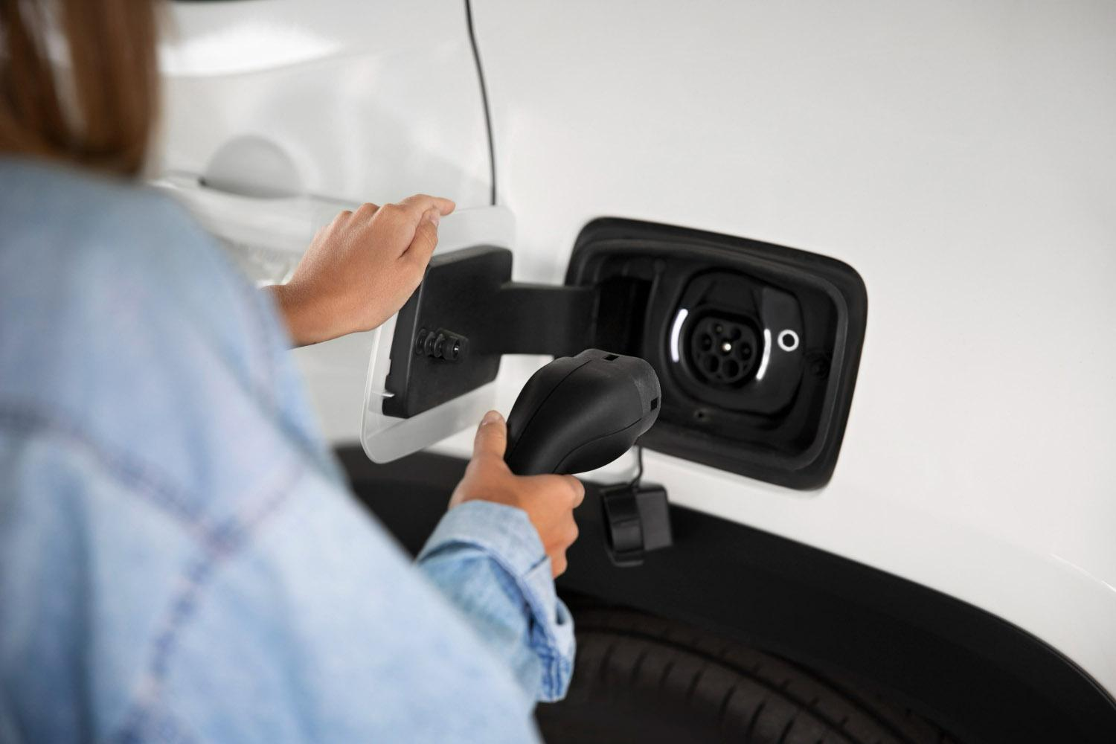



Group 5
Anoushka Priyansha Justin
Nayak Rastogi Chow

Slide 3
Table of contents
01
02
03
04
05
Introduction
Data Cleaning
Exploratory Data Analysis
Problem Statement & Optimization
References

Slide 4
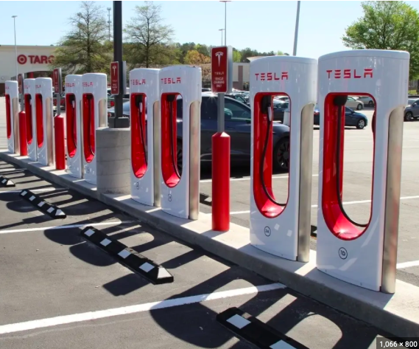
Introduction
11 columns offer a comprehensive view of Tesla's Supercharger network.
Explore geographic and temporal trends in EV support infrastructure.
Assess accessibility in different regions, track Tesla's network growth, and identify potential charging infrastructure gaps.
1. Supercharger 2. Street Address
3. City 4. State
5. Zip 6. Country
7. Stalls 8. kW
9. GPS 10. Elev(m)
11. Open Date
Notes:
This dataset consists of 11 columns that provides an in-depth look into Telsa’s Supercharger network, giving the ability to analyze the distribution, capacity, and growth of Telsa’s charging. It supports a range of analyses, from geographical and logistical to temporal trends in electric vehicle support infrastructure. Users can understand how accessible electric vehicle charging is in different regions, how Tesla's network has grown, and where there may be gaps in the charging infrastructure.

Slide 5
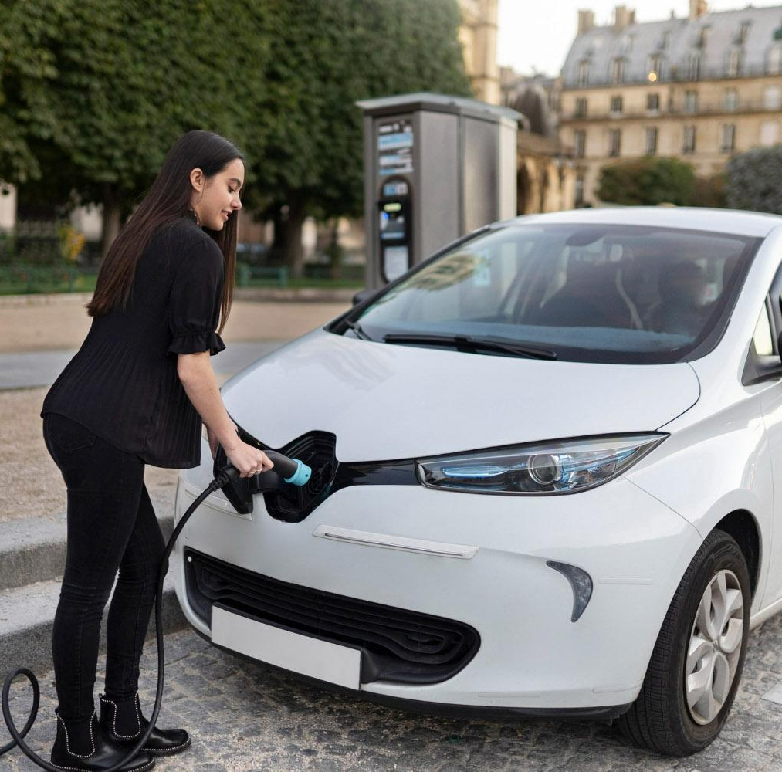
02
Data Cleaning
Notes:
Check for null values. State and Zip Code contained null values that’s why we decided to drop those rows. We used median to fill the missing open date values

Slide 6
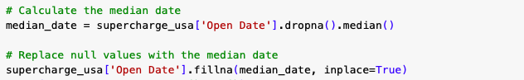
Data Cleaning - Code Snippets
Eliminate Rows with Missing 'State' and 'Zip Code' Data.
Assign missing 'Open Date' Values with Median.
Convert 'Open Date' to Date -Time Format.

Slide 7
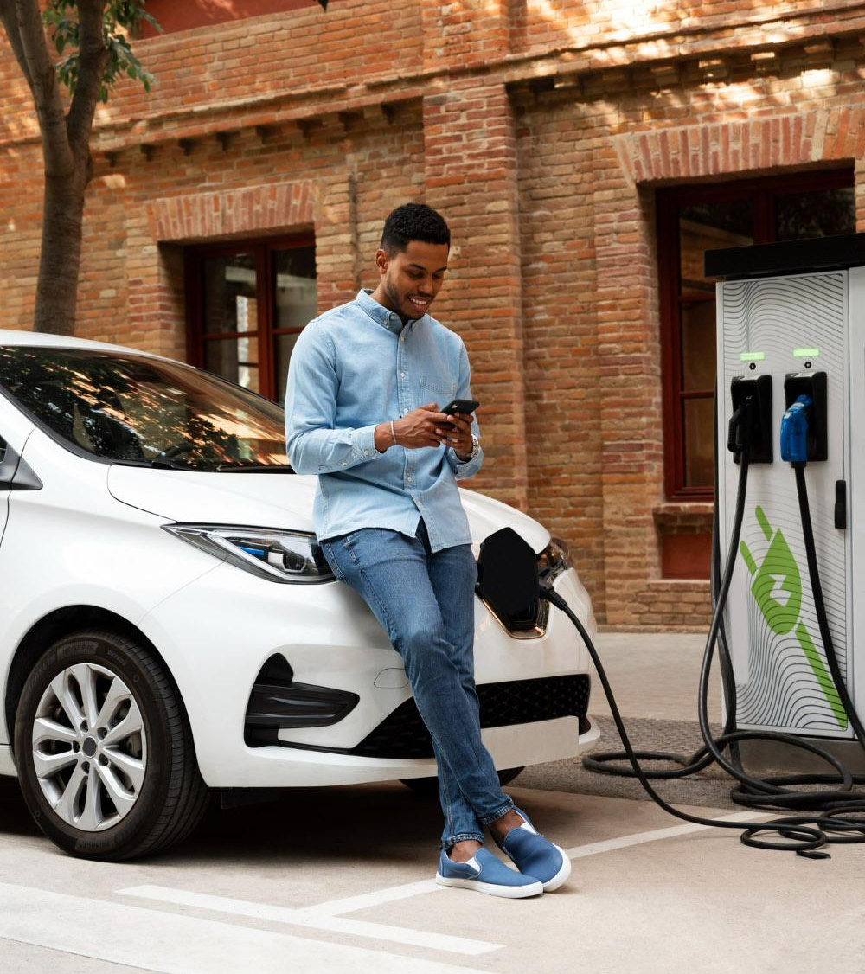
03
Exploratory Data Analysis

Slide 8
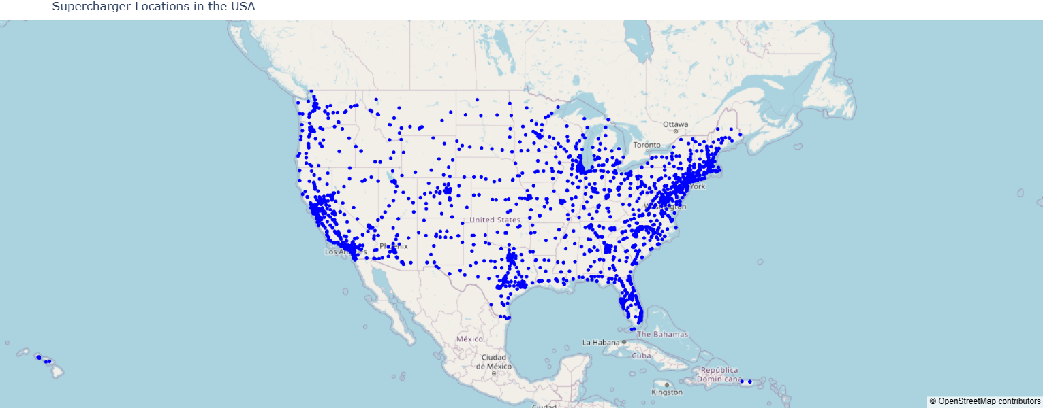
GEOSPATIAL ANALYSIS
Identifying Coverage Gaps
Strategic Planning
Notes:
Identifying Coverage Gaps: Mapping areas that are underserved by superchargers. This information is crucial for planning the expansion of the charging network to ensure adequate coverage and convenience for electric vehicle (EV) users.
Strategic Planning: For businesses and policymakers, the geographic visualization aids in strategic decision-making regarding where to invest in additional infrastructure, considering factors like population density, traffic patterns, and proximity to major highways.

Slide 9
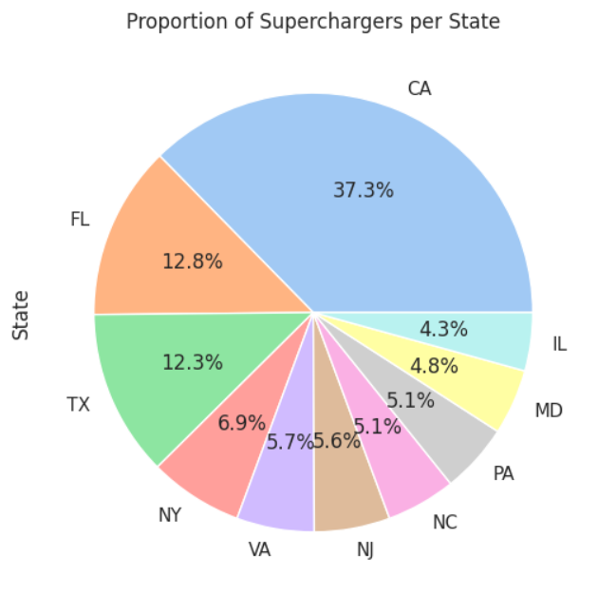
CATEGORICAL DISTRIBUTION ANALYSIS
Categorical Distribution
Proportion of Superchargers per State
Notes:
Categorical Distribution Analysis: a statistical and graphical examination of the distribution of data across different categories or groups. It aims to provide insights into the relative frequencies or proportions of observations within each category, allowing for a comprehensive understanding of the composition of a dataset.

Slide 10
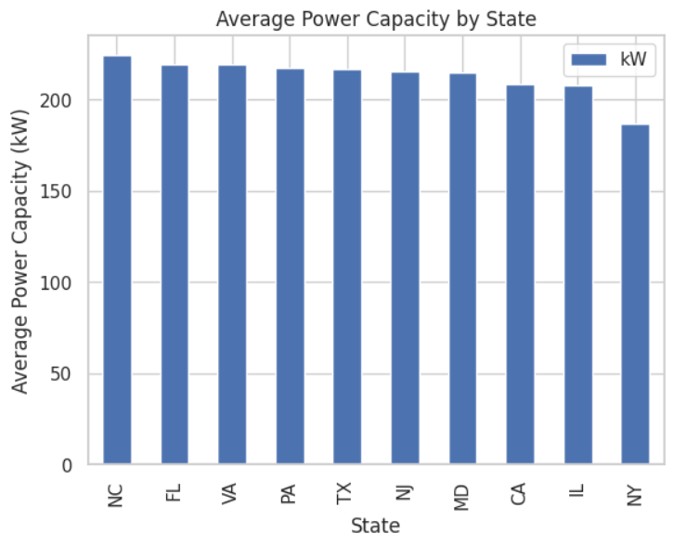
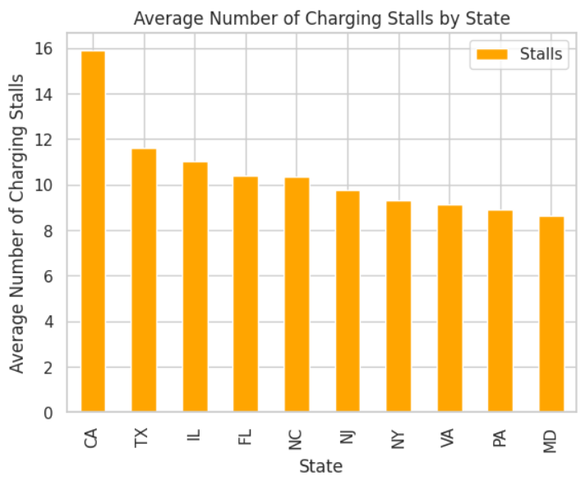
RESOURCE ALLOCATION ANALYSIS
Resource Allocation and Planning
Average kW and Charging Stalls per State
Top 10 States
Notes:
Resource Allocation and Planning: Understanding regional variations helps in efficient allocation of resources. For instance, states with higher traffic may require more stalls or higher power capacity. This analysis can inform where to invest in new infrastructure or upgrade existing facilities.

Slide 11
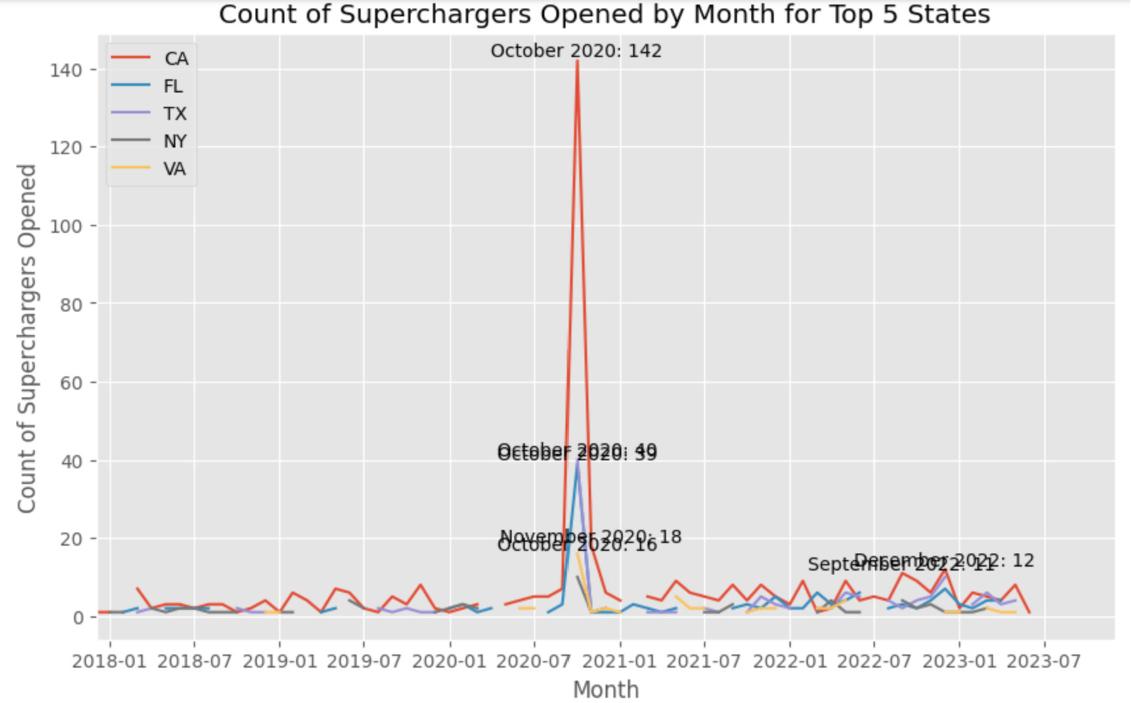
TIME SERIES ANALYSIS
Forecasting
Identify Trends of the SuperChargers Opened
Top 5 States
Notes:
Forecasting: With time series analysis we can forecast future trends. This is valuable for planning purposes, such as anticipating the need for more superchargers or infrastructure upgrades.
Trend Identification: Time series analysis helps in identifying trends over time. For instance, we can use it to determine periods of rapid growth or slowdown in the installation of superchargers. This is crucial for understanding market dynamics and the adoption rate of electric vehicles.

Slide 12
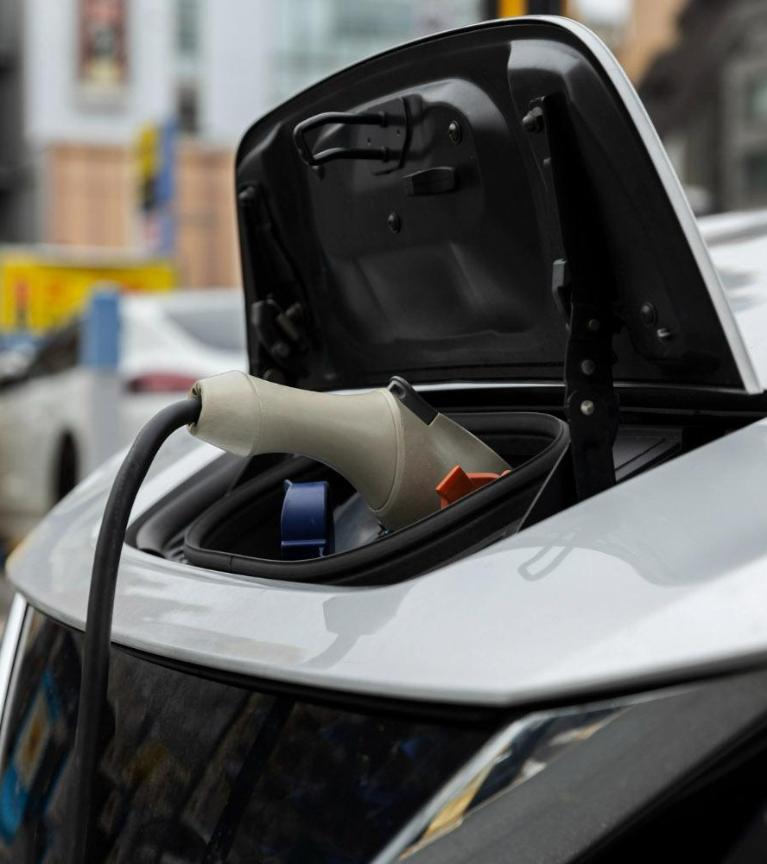
04
Problem Statements
&
Optimization

Slide 13
Problem Statement 1
Objective
Identify optimal locations for Tesla supercharger stations across the USA, accounting for current and anticipated future demand.
Minimize the total distance between these stations, ensuring a well-balanced approach that considers both coverage and cost-effectiveness.
Factors in current and future demand, adapting to the evolving landscape of EV usage and Tesla's market growth.
To address this problem, we reference articles that record Telsa’s annual sales data.
Author: Nikos, Karen Michele
Title: "Tesla’s Advantage: EVS Cannot Succeed without Developing Parallel Supercharging Networks.”
Author: GCBC
Title: “Tesla Sales Figures – U.S Market.”
.
Notes:
With more individuals shifting from traditional fossil fuel vehicles to electric vehicles, the availability of charging stations close to residential areas or along long-distance travel routes is becoming an important factor. That is why the primary objective here is to Identify optimal locations for Tesla supercharger stations across the USA by taking into account the current and future demands We will be minimizing the total distance between these stations, ensuring a well-balanced approach that considers both coverage and cost-effectiveness.
Here coverage refers to minimum and maximum supercharging stations required. To calculate the future demand we took reference from articles like…say the names.

Slide 14
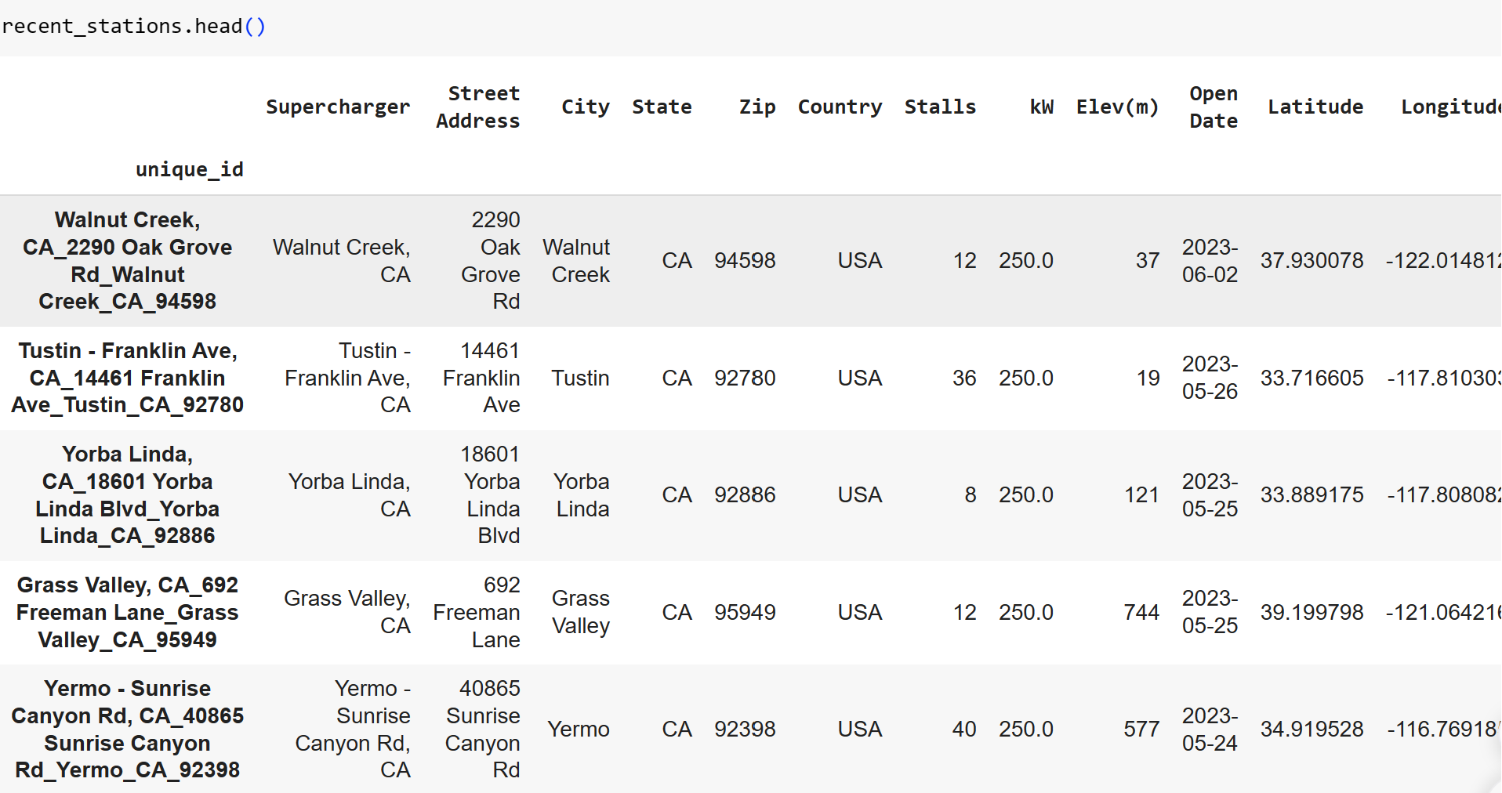
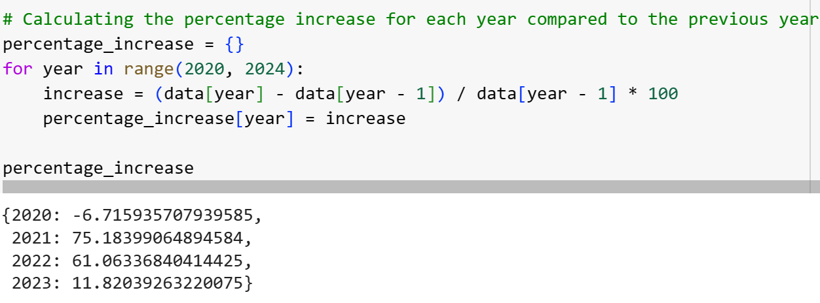
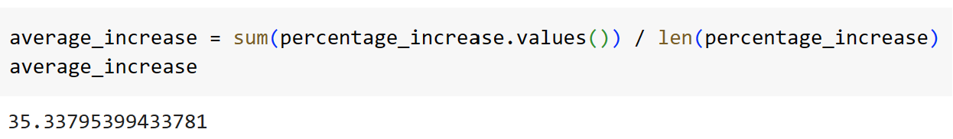
Data Preprocessing
Preprocessing Steps for constraint creation
Generate a Unique ID Column for Distinct Identification of Each Supercharging Station.
Separate GPS Coordinates into Individual Latitude and Longitude Values.
Determine the Average Percentage Increase in Tesla Sales for Future Demand Estimation.
Notes:
Before running the model, we need to calculate the prerequisites.

Slide 15
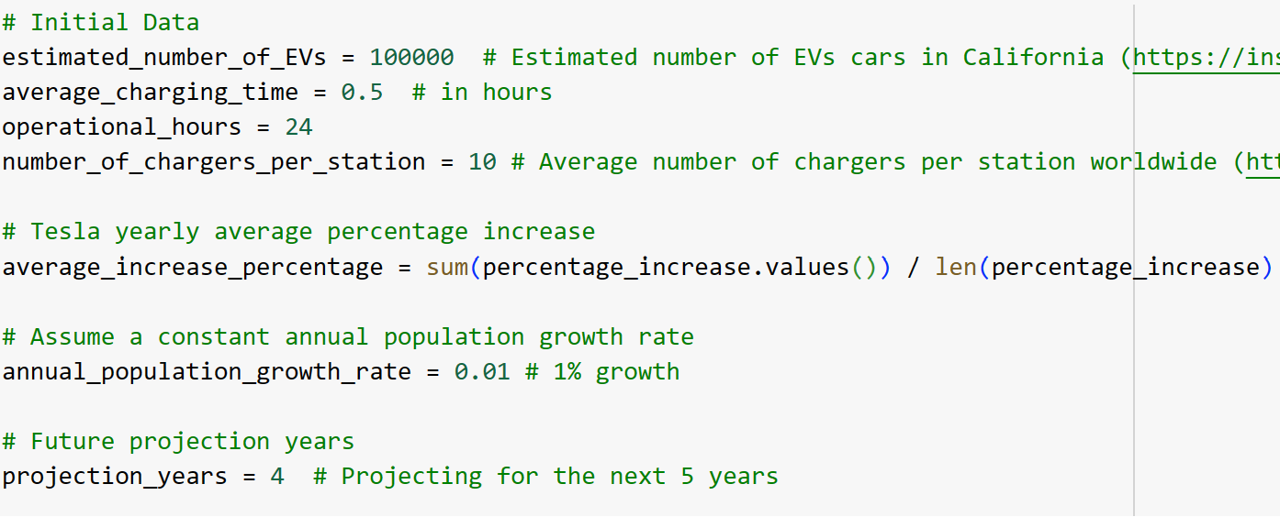
Constraints
Preprocessing Steps for constraint creation
Assess the following factors to Determine the Required Range of Stations (Minimum and Maximum).
Notes:
Before running the model, we need to calculate the prerequisites.

Slide 16
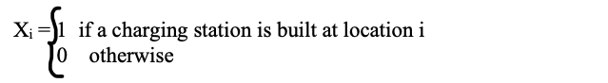
Optimization Function
Decision Variable
Objective Function
Constraints
Minimum Stations Required: min_stations = current_demand / cycles_per_station
Maximum Stations Required: max_stations = min_stations * (1 + growth_rate / 100)
Non-negative Constraints: Since we are considering binary variables, there will be no non-negative constraints
Notes:
Cycles_per_station = total_charging_time / average_charging_time

Slide 17
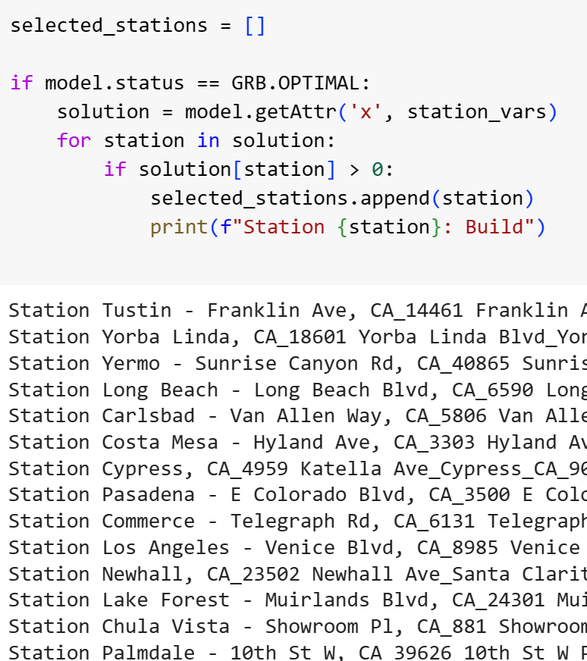
Results
Model is currently running with a 10% optimality gap for a subset of the US dataset.
Preliminary results focus on California, indicating a need for over 80 new supercharging stations.

Slide 18
References
Lambert, Fred. “Tesla’s Supercharger Cost Revealed to Be Just One-Fifth of the Competition in Losing Home State Bid.” Electrek, 15 Apr. 2022, electrek.co/2022/04/15/tesla-cost-deploy-superchargers-revealed-one-fifth-competition/#:~:text=It%20would%20mean%20that%20Tesla%27s,applications%20to%20the%20TxVEMP%20program.
Nikos, Karen Michele. “Tesla’s Advantage: EVS Cannot Succeed without Developing Parallel Supercharging Networks.” UC Davis, 10 Nov. 2021, www.ucdavis.edu/curiosity/news/tesla%E2%80%99s-advantage-evs-cannot-succeed-without-developing-parallel-supercharging-networks.
“Tesla Charging Stations Cost in California.” Energy5, energy5.com/tesla-charging-stations-cost-in-california#anchor-1. Accessed 1 Dec. 2023.
Tesla Sales by State 2023, worldpopulationreview.com/state-rankings/tesla-sales-by-state. Accessed 1 Dec. 2023.
“How Much Does Electricity Cost by State?” EnergySage, www.energysage.com/local-data/electricity-cost/. Accessed 1 Dec. 2023.
Equities, Daniel Shvartsman expertise:, and expertise: Equities. “Tesla Growth and Production Statistics: How Many Vehicles Are Sold across the Globe?” Investing.Com, 29 Nov. 2023, www.investing.com/academy/statistics/tesla-facts/.
Market), Brand Sales (by. “Tesla Sales Figures – U.S Market.” GCBC, www.goodcarbadcar.net/tesla-us-sales-figures/. Accessed 1 Dec. 2023.

